Slide 1
ADAPT technique is an independent predictor of good clinical outcome
(p = 0.049)¹
Comparison of clinical outcomes in patients with acute ischemic strokes treated with mechanical thrombectomy using either Solumbra or ADAPT techniques
1. Delgado Almandoz JE, Kayan Y, Young ML, et al. Comparison of clinical outcomes in patients with acute ischemic strokes treated with mechanical thrombectomy using either Solumbra or ADAPT techniques [Published online ahead of print December, 2015]. J NeuroIntervent Surg. 2015;0:1-6. doi:10.1136/neurintsurg-2015-012122.

Slide 2
Study Background¹
Physician-initiated
Abbott Northwestern
100 patients
45 in ADAPT group
55 in “Solumbra” group
Consecutive patients
Treated between Mar 2012 and Jun 2015
1. Delgado Almandoz JE, Kayan Y, Young ML, et al. Comparison of clinical outcomes in patients with acute ischemic strokes treated with mechanical thrombectomy using either Solumbra or ADAPT techniques [Published online ahead of print December, 2015]. J NeuroIntervent Surg. 2015;0:1-6. doi:10.1136/neurintsurg-2015-012122.

Slide 3
Study Background¹
Angiographic outcomes assessed by 2 neurointerventionalists
SICH determined by consensus with an independent neurologist
1. Delgado Almandoz JE, Kayan Y, Young ML, et al. Comparison of clinical outcomes in patients with acute ischemic strokes treated with mechanical thrombectomy using either Solumbra or ADAPT techniques [Published online ahead of print December, 2015]. J NeuroIntervent Surg. 2015;0:1-6. doi:10.1136/neurintsurg-2015-012122.

Slide 4
Patient Characteristics¹
 | ADAPT | Solumbra | P Value
N | 45 | 55 | NA
Age | 66.1 | 69.6 | 0.16
Mean NIHSS | 19.2 | 16.8 | 0.02
Mean baseline ASPECTS | 9.1 | 8.2 | <0.01
ICA occlusion | 42% | 20% | 0.03
Left side thrombus location | 62% | 49% | 0.23
Severe cervical tortuosity (≥360 degrees) | 33% | 15% | 0.03
Bold = Statistically significant
1. Delgado Almandoz JE, Kayan Y, Young ML, et al. Comparison of clinical outcomes in patients with acute ischemic strokes treated with mechanical thrombectomy using either Solumbra or ADAPT techniques [Published online ahead of print December, 2015]. J NeuroIntervent Surg. 2015;0:1-6. doi:10.1136/neurintsurg-2015-012122.

Slide 5
“The ADAPT technique was a statistically significant independent predictor of a good clinical outcome at 90 days…” (p = 0.049) ¹
1. Delgado Almandoz JE, Kayan Y, Young ML, et al. Comparison of clinical outcomes in patients with acute ischemic strokes treated with mechanical thrombectomy using either Solumbra or ADAPT techniques [Published online ahead of print December, 2015]. J NeuroIntervent Surg. 2015;0:1-6. doi:10.1136/neurintsurg-2015-012122.

Slide 6
ADAPT: Improved Functional Independence¹
P = 0.015
N = 25/45
N = 17/55
1. Delgado Almandoz JE, Kayan Y, Young ML, et al. Comparison of clinical outcomes in patients with acute ischemic strokes treated with mechanical thrombectomy using either Solumbra or ADAPT techniques [Published online ahead of print December, 2015]. J NeuroIntervent Surg. 2015;0:1-6. doi:10.1136/neurintsurg-2015-012122.

Slide 7
ADAPT: Lower Hemorrhage Rates¹
 | ADAPT (n = 45) | Solumbra (n = 55) | P Value
ICH | 22% | 47% | 0.01
SAH | 7% | 24% | 0.03
SICH | 2% | 13% | 0.07
Bold = Statistically significant
1. Delgado Almandoz JE, Kayan Y, Young ML, et al. Comparison of clinical outcomes in patients with acute ischemic strokes treated with mechanical thrombectomy using either Solumbra or ADAPT techniques [Published online ahead of print December, 2015]. J NeuroIntervent Surg. 2015;0:1-6. doi:10.1136/neurintsurg-2015-012122.

Slide 8
ADAPT: Improved Clinical Measures¹
 | ADAPT (n = 45) | Solumbra (n = 55) | P Value
Mean Neuro ICU LOS (length of stay in days) | 2.4 | 3.7 | 0.04
90-day mortality | 18% | 29% | 0.24
Bold = Statistically significant
1. Delgado Almandoz JE, Kayan Y, Young ML, et al. Comparison of clinical outcomes in patients with acute ischemic strokes treated with mechanical thrombectomy using either Solumbra or ADAPT techniques [Published online ahead of print December, 2015]. J NeuroIntervent Surg. 2015;0:1-6. doi:10.1136/neurintsurg-2015-012122.

Slide 9
“Clinical outcomes were more favorable in the ADAPT group despite a higher proportion of patients with ICA terminus thrombi, higher presenting NIHSS, and more patients with severe cervical vascular tortuosity. ¹”
1. Delgado Almandoz JE, Kayan Y, Young ML, et al. Comparison of clinical outcomes in patients with acute ischemic strokes treated with mechanical thrombectomy using either Solumbra or ADAPT techniques [Published online ahead of print December, 2015]. J NeuroIntervent Surg. 2015;0:1-6. doi:10.1136/neurintsurg-2015-012122.

Slide 10
Backup

Slide 11
Thrombectomy Devices Used¹
 | ADAPT | Solumbra
Thrombectomy Devices | ACE: 88.9% 5MAX: 6.7% ACE64: 4.4% | Solitaire™ FR: 90.9% Trevo®: 9.1%
1. Delgado Almandoz JE, Kayan Y, Young ML, et al. Comparison of clinical outcomes in patients with acute ischemic strokes treated with mechanical thrombectomy using either Solumbra or ADAPT techniques [Published online ahead of print December, 2015]. J NeuroIntervent Surg. 2015;0:1-6. doi:10.1136/neurintsurg-2015-012122.
Product availability aries by country.

Slide 12
Procedural Results¹
 | ADAPT (n = 45) | Solumbra (n = 55) | P Value
TICI 2b/3 | 89% | 84% | 0.6
Time from puncture to reperfusion (mean min) | 50 | 51 | 0.8
Number of passes (mean) | 3.3* | 2.2 | 0.02
Note: ICA occlusions comprised 42% of cases in ADAPT vs 20% in Solumbra. P = 0.03
* Includes total number of ADAPT and Solumbra passes in cases where Solumbra salvage was needed
1. Delgado Almandoz JE, Kayan Y, Young ML, et al. Comparison of clinical outcomes in patients with acute ischemic strokes treated with mechanical thrombectomy using either Solumbra or ADAPT techniques [Published online ahead of print December, 2015]. J NeuroIntervent Surg. 2015;0:1-6. doi:10.1136/neurintsurg-2015-012122.

Slide 13
Techniques¹
ADAPT
Sheath: NeuronMAX 088
Velocity + 0.016" wire used to deliver ACE or ACE64
3 aspiration attempts with MAX pump before using stent retriever/Solumbra
Solumbra
Use of stent retriever with aspiration
1. Delgado Almandoz JE, Kayan Y, Young ML, et al. Comparison of clinical outcomes in patients with acute ischemic strokes treated with mechanical thrombectomy using either Solumbra or ADAPT techniques [Published online ahead of print December, 2015]. J NeuroIntervent Surg. 2015;0:1-6. doi:10.1136/neurintsurg-2015-012122.
Product availability aries by country.

Slide 14
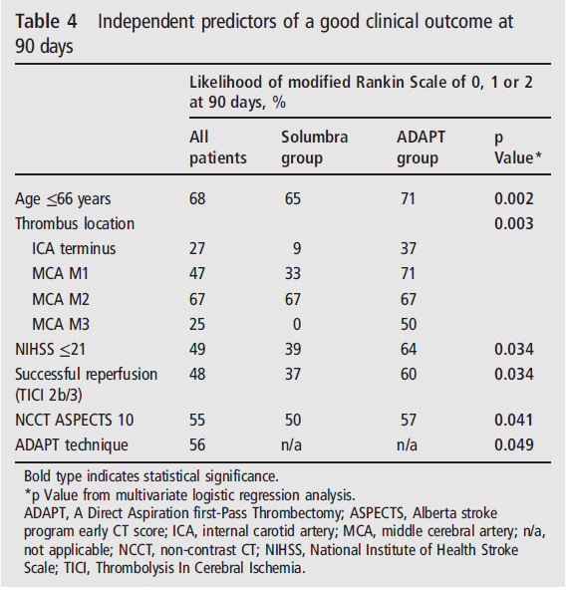
Independent Predictors of Good Clinical Outcome¹
1. Delgado Almandoz JE, Kayan Y, Young ML, et al. Comparison of clinical outcomes in patients with acute ischemic strokes treated with mechanical thrombectomy using either Solumbra or ADAPT techniques [Published online ahead of print December, 2015]. J NeuroIntervent Surg. 2015;0:1-6. doi: 10.1136neurintsurg- 2015-012122.
.

